Slide 1
Government expenditure on health care.
Student name
Professor
Course
Date

Slide 2
Government expenditure in u.s
In last year, the government of united states spent about $7.3 trillion in all-out government use and $21.4 trillion absolute GDP which is about 34%. This administration absolute bars spending by government undertakings which sell merchandise and ventures "to families and organizations in market exchange. One of the sector among all the other expenditure is health care (Martinez, 2020).. Below I discuss how the government of the united states spends money in health care.

Slide 3
GOVERNMENT EXPENDITURE ON HEALTH CENTRES.
There is some essential expenditure that is mandatory in the united states of America (Martinez, 2020). One of the sector among all the other expenditure is health care. Below I discuss how the government of the united states spends money in health care. This administration absolute bars spending by government undertakings which sell merchandise and ventures "to families and organizations in market exchange. Which is administration endeavors" incorporate the U.S

Slide 4
Heath expenditure in united states annually.
These expenditures include health care, long term care, medical goods and services, gathered taxes, supplementary services, and protective and public health services like the wellbeing of people. According to the statistics, the cost of wellbeing is very expensive. It accounts for 90% expenditure of the state in an year. This is information according to the year 2019 (Martinez, 2020).

Slide 5
Heath expenditure in united states annually
As indicated by government information, while the costliest 1% of patients represent 20% of all medicinal services spending in the United States (Himmelstein, 2020). About 10% of the populace devours 63% of the all-out medicinal services dollars in the nation. Individuals with at least three ceaseless ailment conditions by and large fall into that around 1% classification.

Slide 6
A chart of health centres expenditure in 2019

Slide 7
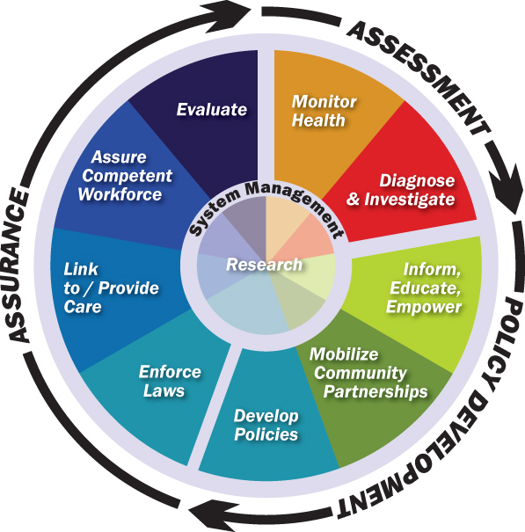
The 10 Essential Public Health Services

Slide 8
References.
Himmelstein, D. U., Campbell, T., & Woolhandler, S. (2020). Health care administrative costs in the United States and Canada, 2017. Annals of Internal Medicine, 172(2), 134-142.
Martinez, G. S., Chu, J., Marachelian, A., & Gomez, M. (2020). More Than Health Care: The Value of Addressing Health, Education, and Social Service Need Together Through Community Health Centers. The Journal of ambulatory care management, 43(1), 41-54.

